Slide 1
Lecture 10
Petri Net

Slide 2
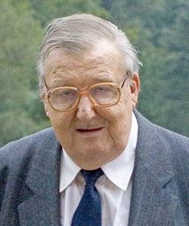
Petri Net
Carl Adam Petri (12 July 1926 – 2 July 2010) was a German mathematician and computer scientist.
Petri nets were invented in August 1939 at the age of 13 for the purpose of describing chemical processes.
He documented the Petri net in 1962 as part of his PhD thesis.

Slide 3
Applications
Industry standards such as UML activity diagrams Petri nets offer a graphical notation for stepwise processes that include iteration, and concurrent execution.
Modelling concurrent and/or distributed systems
Communication protocols, computer networks, manufacturing system, public transport systems etc.

Slide 4
Petri net definition
(P, T, A, w)
Places, P = {p₁, p₂, …, p_{n}} |P| = n
Transitions, T = {t₁, t₂, …, t_{m}} |T| = m
Arcs, A ⊆ (T×P)∪(P×T)
Weight function w : A→{1, 2, 3, … }

Slide 5
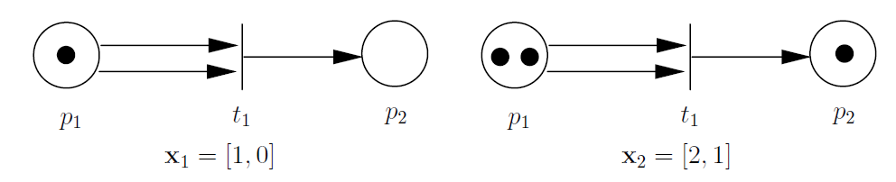
Petri net markings
A marked Petri net is a five-tuple (P, T, A, w, x) where (P, T, A, w) is a Petri net graph and x is a marking of the set of places P; x = [x(p₁), x(p₂), . . . , x(p_{n})] ∈ N^{n} is the row vector associated with x.

Slide 6
Petri net dynamics
Definition. (Petri net dynamics)
The state transition function, f : N^{n} × T → N^{n}, of Petri net (P, T, A, w, x) is defined for transition t_{j} ∈ T if and only if
x(p_{i}) ≥ w(p_{i}, t_{j}) for all p_{i} ∈ I(t_{j})
If f(x, t_{j}) is defined, then we set x = f(x, t_{j} ), where
x’(p_{i}) = x(p_{i}) − w(p_{i}, t_{j}) + w(t_{j}, p_{i}), i = 1, . . . , n

Slide 7
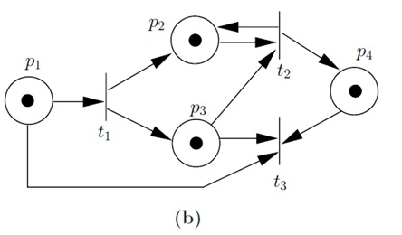
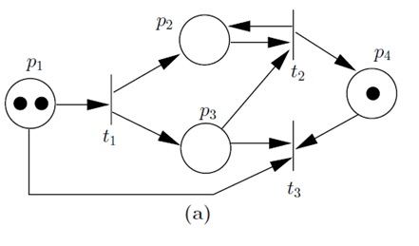
Firing of transitions

Slide 8
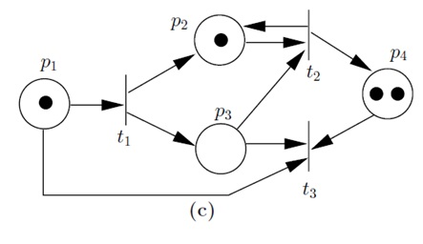
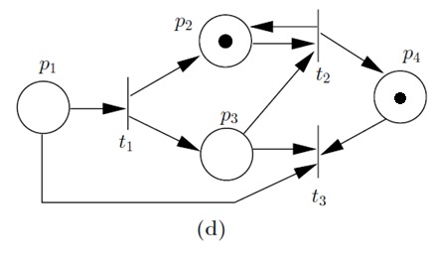
Firing of transitions

Slide 9

State equation
State update equation
Incidence matrix A [dimension m×n]
u is called the coordinates of the transaction or Firing vector
Ex: Consider a case of 3 transaction, then
for t₁ it is [1 0 0]
for t₂ it is [0 1 0]
for t₃ it is [0 0 1]

Slide 10
State equation
To draw matrix from graph, follow the given instructions:
If a transaction t receive an arc, then -1
If a transaction t send an arc, then +1
If a transaction t not send neither receive an arc, then 0
If a transaction t both send and receive an arc, then ±0

Slide 11
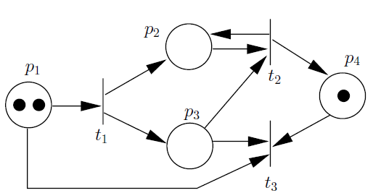
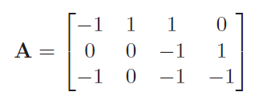

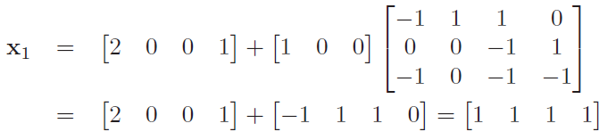
State equation

Slide 12
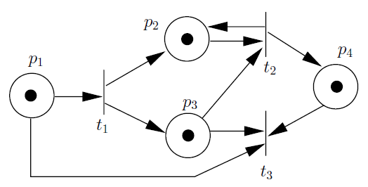
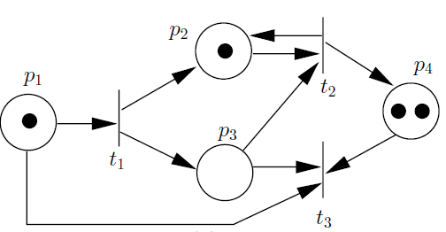
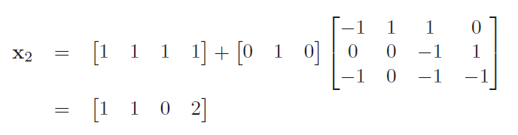

State equation

Slide 13
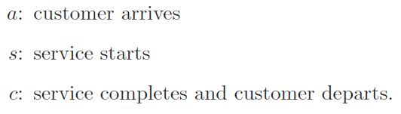
Petri net models of queueing systems
T = {a, s, c}
P = {Q, I, B}

Slide 14
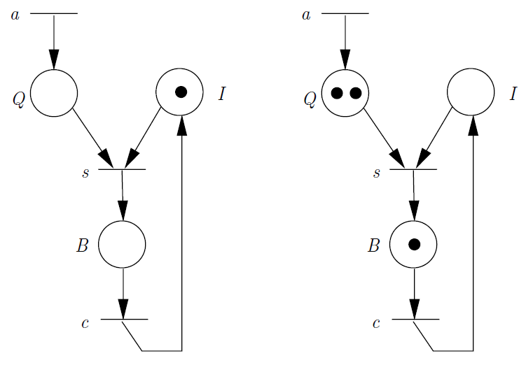
Petri net (M/M/1 Queue)
{a, s, a, a, c, s, a}

Slide 15
Petri net (M/M/1 Queue)

